Slide 1
CELL STRUCTURE AND ITS FUNCTIONS
1

Slide 2
A Cell (from Latin cella, meaning "Small Room") is the basic Structural, Functional, and Biological unit of all known Living Organisms. A cell is the Smallest Unit of life that can replicate independently, and cells are often called the "Building Blocks of Life".
5/26/2020
TOPIC/COURSE CODE-NAME/FACULTY/DEPT/COLLEGE
3/10

Slide 3
CONTENT SLIDE
5/26/2020
TOPIC/COURSE CODE-NAME/FACULTY/DEPT/COLLEGE

Slide 4
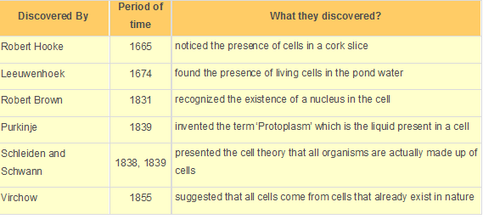
CONTENT SLIDE
5/26/2020
TOPIC/COURSE CODE-NAME/FACULTY/DEPT/COLLEGE
6/10

Slide 5
In 1830s, two German scientists called Matthias Schleiden and Theodor Schwann proposed the Cell Theory which stated: All living organisms are made of cells. Cells are basic structural or functional units of living organisms. All cells are born out of pre-existing cells through cell division.

Slide 6
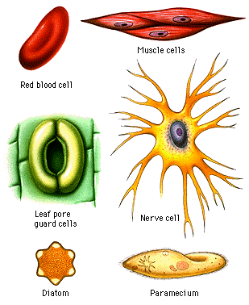
SHAPES OF CELL

Slide 7
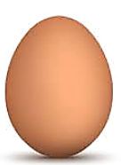
Size of Cells The size of the cells may vary from a millionth of a metre (known as a micron) to a few centimetres but most of them cannot be seen with the naked eye. We need microscopes to see these microscopic cells. It is not necessary that the size of cells of a large animal (such as an elephant) will be larger than cells of a small animal (such as a rat). The size of the cell depends on the function it performs. For example, nerve cells of a rat and nerve cells of an elephant perform the same functions and hence, are of the same size.

Slide 8
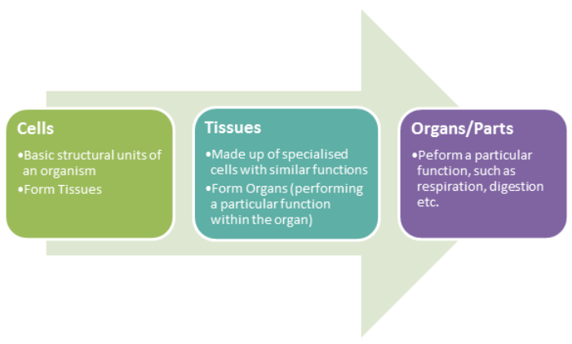

Slide 9
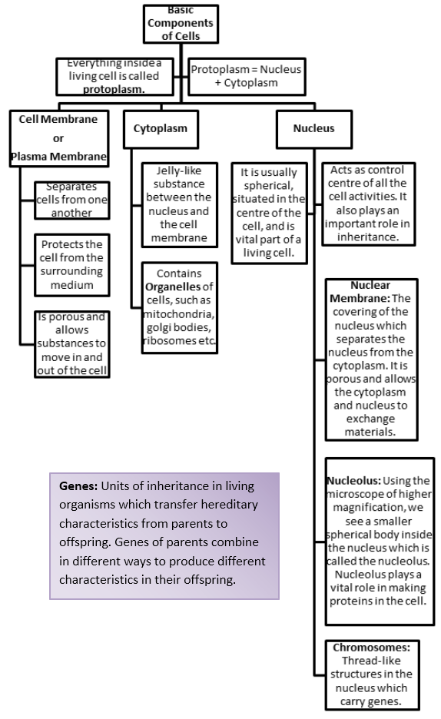

Slide 10
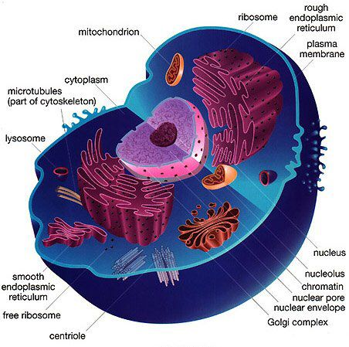

Slide 11
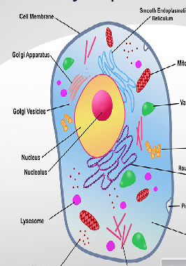
Cytoplasm
The plasma membrane has a fluid like substance in it which is called the cytoplasm.
The cytoplasm contains several organelles that can perform distinct functions of the cell
Functions of Cytoplasm
It supports and suspends the cell organelles and molecules.
The cellular processes occur in cytoplasm such as formation of proteins.
It allows movement of substances in the cell such as hormones.
It dissolves cellular wastes.

Slide 12
Cell Organelles
In the case of Eukaryotic organisms, the cells contain organelles that have their own membranes apart from the overall cell membrane of the cell.
Significance of membrane-bound organelles
The cells perform several functions.
The organelles are useful because they allow separation of different functions that are being performed by the cell.

Slide 13
Endoplasmic Reticulum (ER)
The structure of the ER is quite similar to that of the plasma membrane. It is a network-like structure which consists of membrane-bound tubes and sheets.
Two types of ER –
Rough ER
Smooth ER
Rough ER contains ribosomes that are responsible for the manufacturing of proteins in the cells. They give a rough texture to the cell.
The smooth ER manufactures fats or lipids in the cell which allow the functioning of the cell.

Slide 14
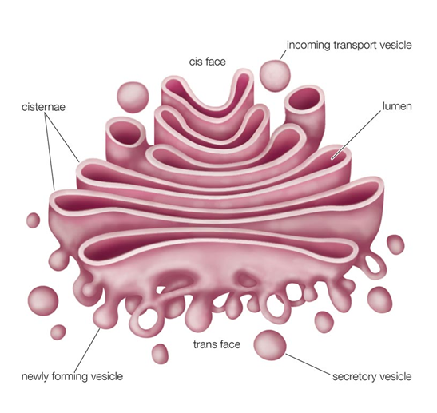
Golgi App Camillo Golgi discovered the Golgi Apparatus.
It contains vesicles that are arranged parallel in stacks. These stacks are called Cisterns. These vesicles have their own membranes. These membranes are sometimes connected to those of the ER.
Functions of Golgi Apparatus
Golgi apparatus carries materials synthesized by the ER to different parts of the cell. The material is stored and packaged in vesicles.
Formation of complex sugar
Formation of lysosomes

Slide 15
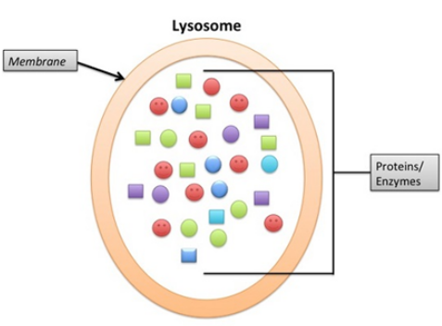
Lysosomes
They are single membrane vesicles which are responsible for cleaning the cell. They can digest any foreign material such as food or bacteria and even the worn out cell organelles.
Lysosomes are capable of doing so because they have digestive enzymes in them. These enzymes break the materials and digest them. These enzymes are synthesized by RER and packaged into lysosome by Golgi bodies.
Why lysosomes are called ‘suicide bags’?
If the cell’s own material gets damaged or dead gets there are chances that lysosomes burst out, thus digesting its own cell.

